Slide 1
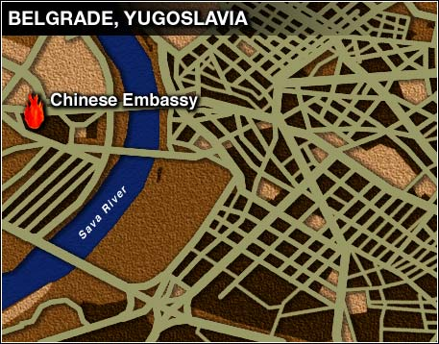
Managing Uncertainty
Geo580, Jim Graham

Slide 2
Topic: Uncertainty
Why it’s important:
  How to keep from being “wrong”
Definitions:
  Gross errors, accuracy (bias), precision
Sources of uncertainty
Estimating uncertainty
Reducing uncertainty
Maintaining uncertainty
Reporting

Slide 3
Consequences
Users assume data is appropriate for their use regardless of hidden uncertainty
“Erroneous, inadequately documented, or inappropriate data can have grave consequences for individuals and the environment.”
(AAG Geographic Information Ethics Session Description, 2009)

Slide 4
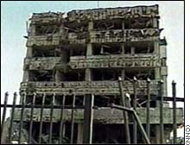
1999 Belgrade Bombing
In 1999 the US mistakenly bombed the Chinese embassy in Belgrade
Had successfully bombed 78 targets
Did not have the new address of the Chinese embassy
Used “Intersection” method
This was a GIS process error!
https://www.cia.gov/news-information/speeches-testimony/1999/dci_speech_072299.html
Notes:
https://www.cia.gov/news-information/speeches-testimony/1999/dci_speech_072299.html

Slide 5
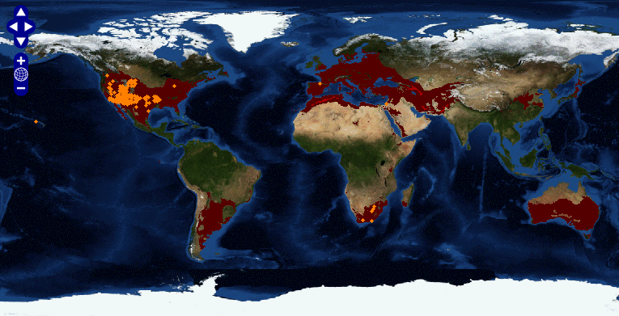
LifeMapper: Tamarix chinensis
LifeMapper.org

Slide 6
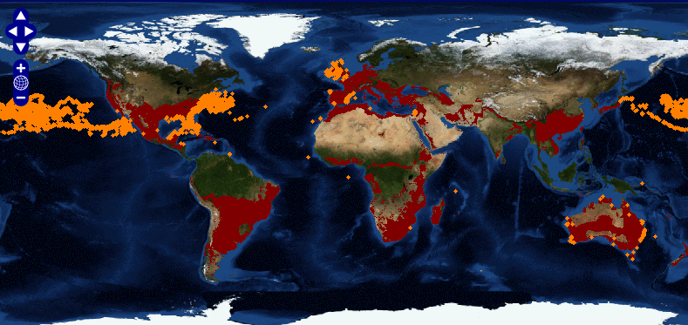
LifeMapper: Loggerhead Turtles
LifeMapper.org

Slide 7
Take Away Messages
No data is “correct”:
  All data has some uncertainty
Manage uncertainty:
  Have a protocol for data collection
  Investigate the uncertainty of acquired data
  Manage uncertainty throughout processing
  Report uncertainty in metadata and documents
This will help others make better decisions

Slide 8
Sources of Uncertainty
Uncertainty?
Real World
Protocol Errors, Sampling Bias, and Instrument Error
Measurements
Unintended Conversions
Storage
Digital Copy
Uncertainty increases with processing, human errors
Processing
Incorrect method, interpretation errors
Analysis
Representation errors
Results
Interpretation errors
Decisions
Notes:
There are lots of sources of error/uncertainty
All we can do is understand them, maintain information on them, and communicate them as best we can
Did you calibrate your instrument?

Slide 9
Definitions: Uncertainty
Types
  Gross Errors
  Accuracy (Bias)
  Precision
Issues
  Drift over time
  Gridding
  Collection bias
  Conversions
  Digits after the decimal in coorinates
Sources
  People
  Instruments
  Transforms (tools)
  Protocol(s)
  Software

Slide 10
Dimensions of Spatial Data
Space:
  Coordinate uncertainty
Time:
  When collected? Drift?
Attributes:
  Measurement uncertainty
Relationships
  Topological errors

Slide 11
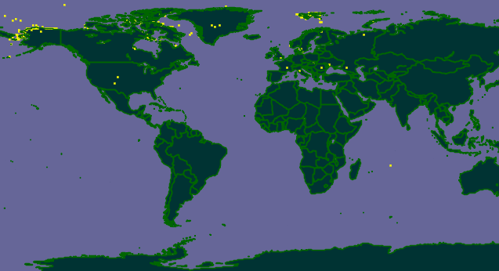
Polar Bears
Polar Bears
Ursus maritimus occurrences from GBIF.org, Jan 1st, 2013

Slide 12
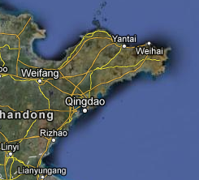
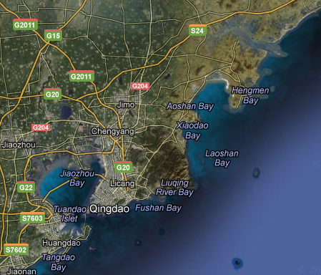
Coastline of China
1920
  9,000 km
1950s
  11,000 km
1960s
  14,000 km at scale of 1:100,000
  18,000 km at scale of 1:50,000
Notes:
What is the “length” of the coastline of China?

Slide 13
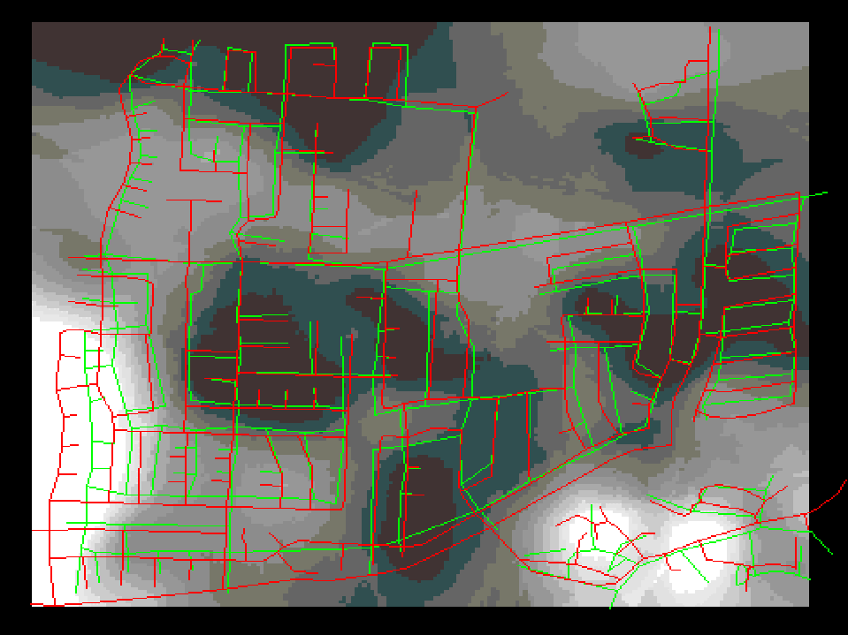

Slide 14
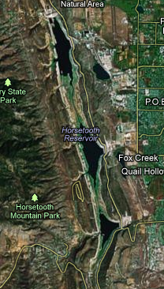
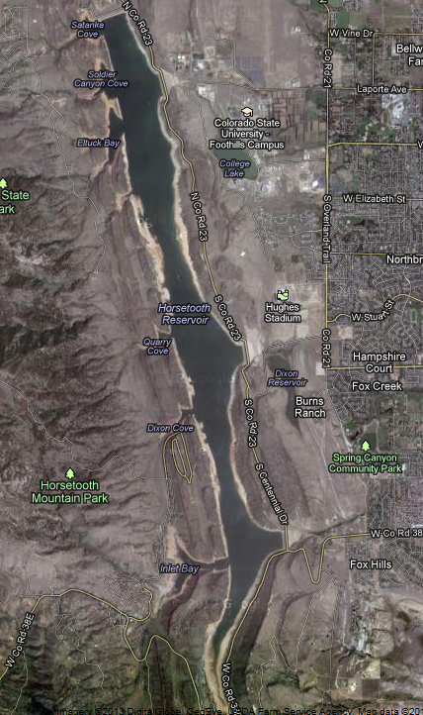
Horsetooth Lake - Colorado

Slide 15
Inputs
Gross Errors
Precision
Accuracy (Bias)
Estimate
Estimate
Estimate
Remove
Maintain
Remove/Compensate
Report

Slide 16
Protocol
Rule #1: Have one!
Step by step instructions on how to collect the data
  Calibration
  Equipment required
  Training required
  Steps
  QAQC
See Globe Protocols:
  http://www.globe.gov/sda/tg00/aerosol.pdf

Slide 17
Gross Errors
Wrong Datum, missing SRS
Data in wrong field/attribute
Transcription errors
  Lat swapped with Lon
  Dropped negative sign

Slide 18
Gross Errors
Estimating:
  How many did you find?
  How many didn’t you find?
Removing Errors:
  Only after estimating
Maintaining:
  Review process
Report:
  Gross errors found
  Estimate of gross errors still remaining

Slide 19


Accuracy and Precision
High Accuracy
Low Precision
Low Accuracy
High Precision
http://en.wikipedia.org/wiki/Accuracy_and_precision
Notes:
These are the formal terms, accuracy is often used to refer to uncertainty in general

Slide 20
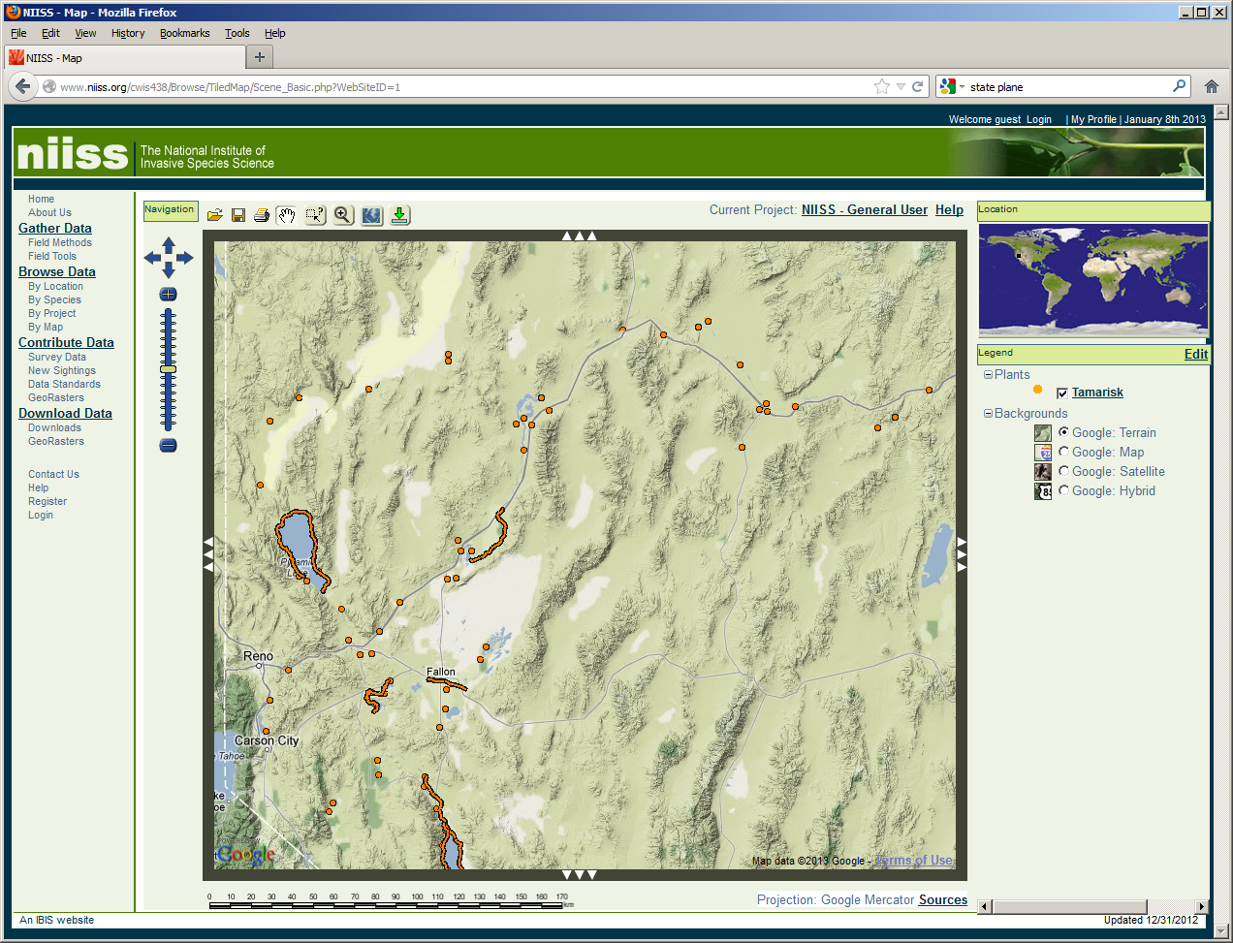
Bias

Slide 21
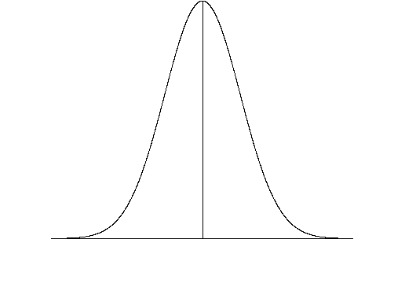
Bias (Accuracy)
Bias
Truth
Mean
Bias = Distance from truth

Slide 22
Bias
Estimating:
  Have to have “ground-truth” data
  RMSE (sort of)
Compensating:
  Spatially:
    Re-georeference data
    If there are lots of points:
      Adjust the “measures” by the “bias”
  Dates:
    Remove samples from January 1st

Slide 23
January 1st Dates
If you put just a “year”, like 2011, into a relational database, the database will return:
  Midnight, January 1st, of that year
In other words:
  2011 becomes:
  2011-01-01 00:00:00.00

Slide 24
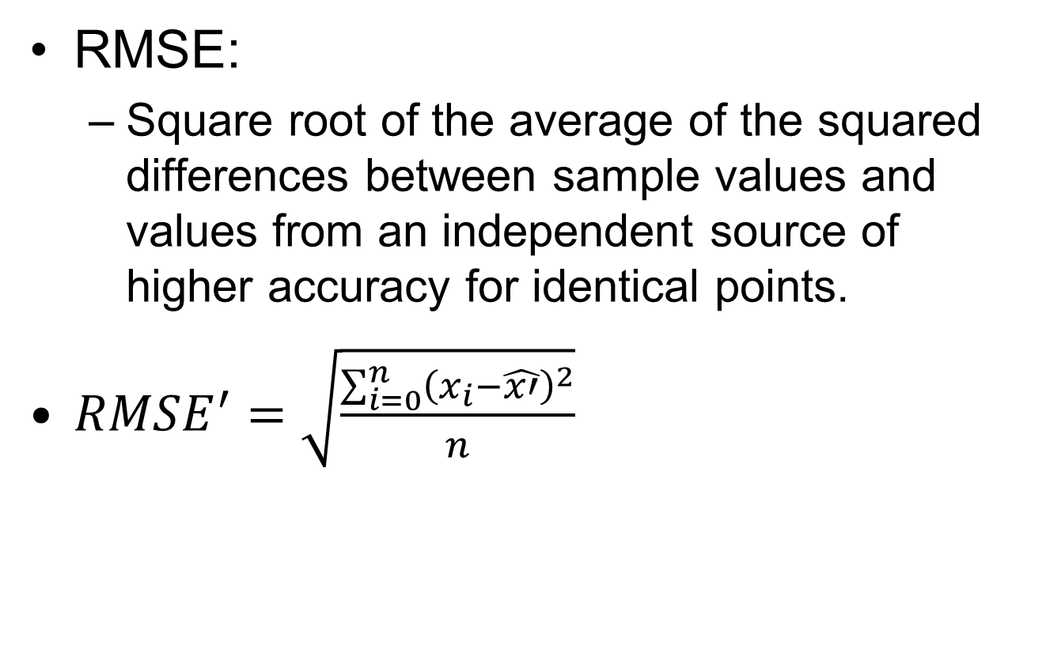
RMSE From Higher Accuracy

Slide 25
Precision
Estimate:
  Standard Deviation: Precision
  Standard Error: Precision
  Confidence Interval: Precision
  Min/Max: Precision
Manage:
  Significant Digits
  Data types: Doubles, Long Integers
Report

Slide 26

Standard Deviation (Precision)
Each band represents one standard deviation
Source: Wikipedia
Notes:
26

Slide 27
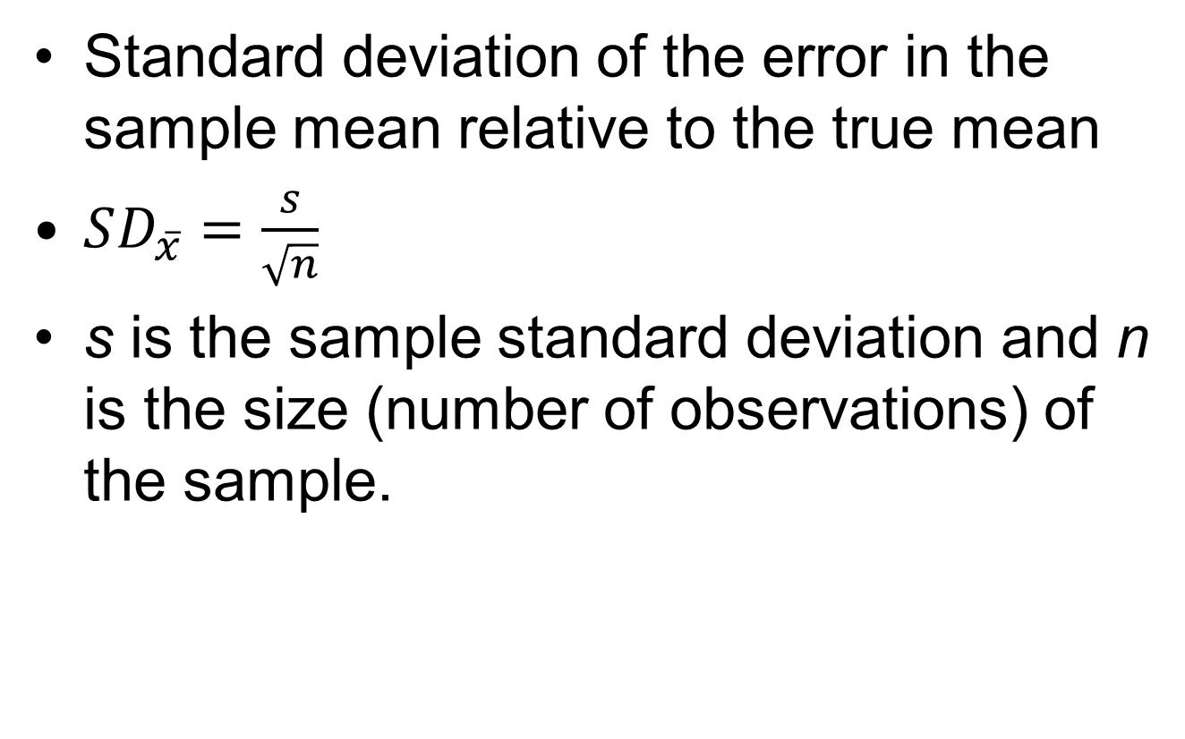
Standard Error of Sample Mean
Wikipedia
Notes:
S=(i.e., the sample-based estimate of the standard deviation of the population),

Slide 28
Confidence Interval: 95%
95%, typically means that your model will be within the interval 95% of the times you collect data and build the model

Slide 29
Min/Max or Plus/Minus: Range
Does this really mean all values fall within range?

Slide 30
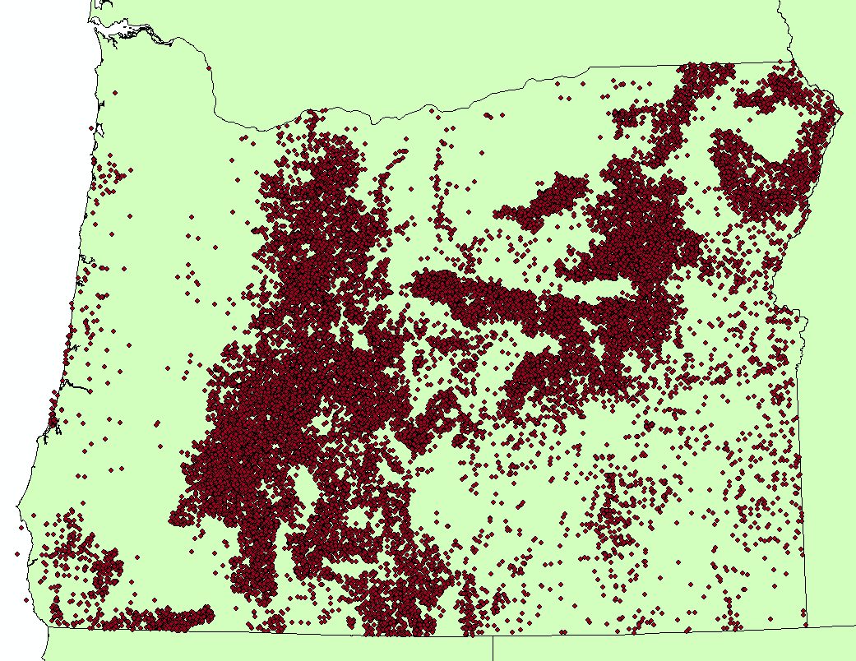
Oregon Fire Data

Slide 31
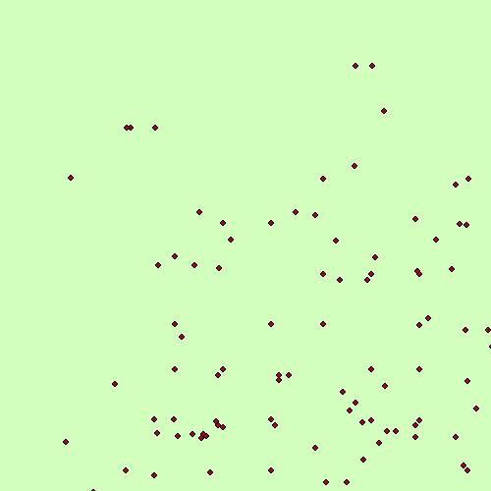
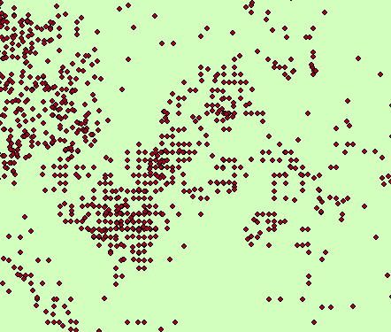
What’s the Resolution?

Slide 32
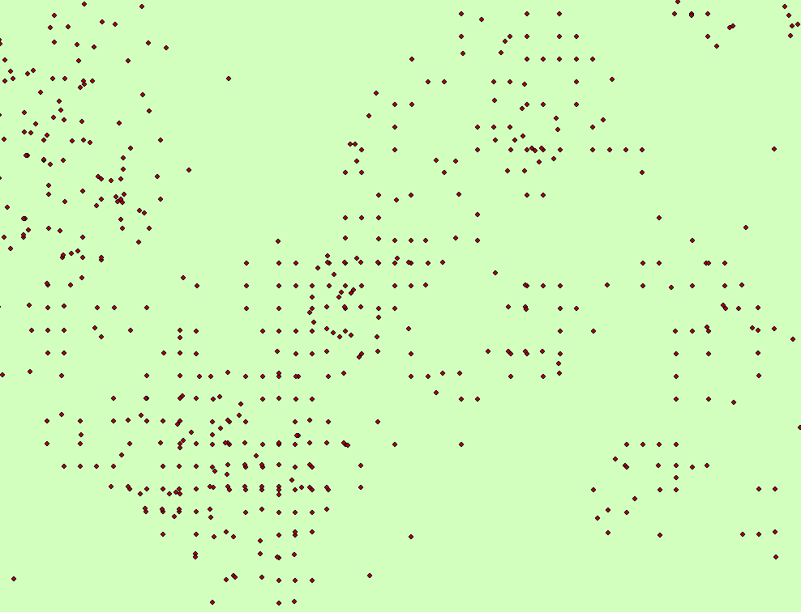
Gridded Data

Slide 33
Quantization/Gridding
Fires
Esimating: minimum distance histogram
Removing: Can’t?
Reporting:

Slide 34
Errors in Interpolated Surfaces
Kriging provides standard error surface
  Only esimates the error from interpolating!
Can use Cross-Validation with other methods to obtain overall RMSE
“Perturb” the inputs to include existing uncertainties

Slide 35
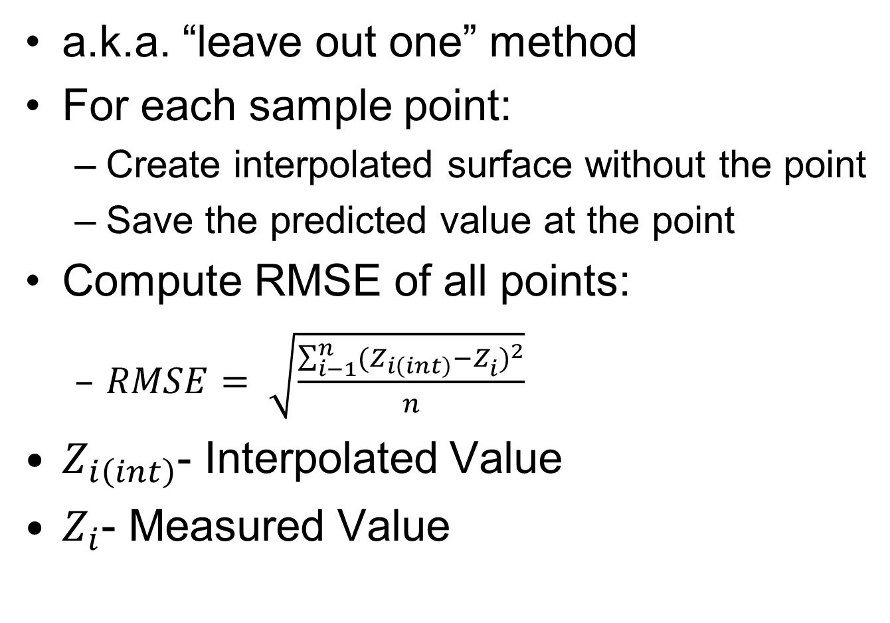
Cross-validation
Maciej Tomczak , Spatial Interpolation and its Uncertainty Using Automated Anisotropic Inverse Distance Weighting (IDW) - Cross-Validation/Jackknife Approach
, Journal of Geographic Information and Decision Analysis, vol. 2, no. 2, pp. 18-30, 1998
Notes:
Precision

Slide 36
Managing Uncertainty
Solution 1
  Compute uncertainty throughout processing
  Difficult
Solution 2
  Maintain a set of “control points”
    Represent the full range of values
  Duplicate all processing on the control points
  At least measure their variance in the final data set

Slide 37
Documenting Uncertainty
Record accuracy and precision in metadata!
Add uncertainty to your outputs
  Data sources
  Sampling Procedures and Bias
  Processing methods
  Estimated uncertainty
Add “caveats” sections to manuscripts
Be careful with “significant digits”
  Some will interpret as “precision”

Slide 38
Documenting Uncertainty
For each dataset, include information on:
  Gross errors
  Accuracy
  Precision

Slide 39
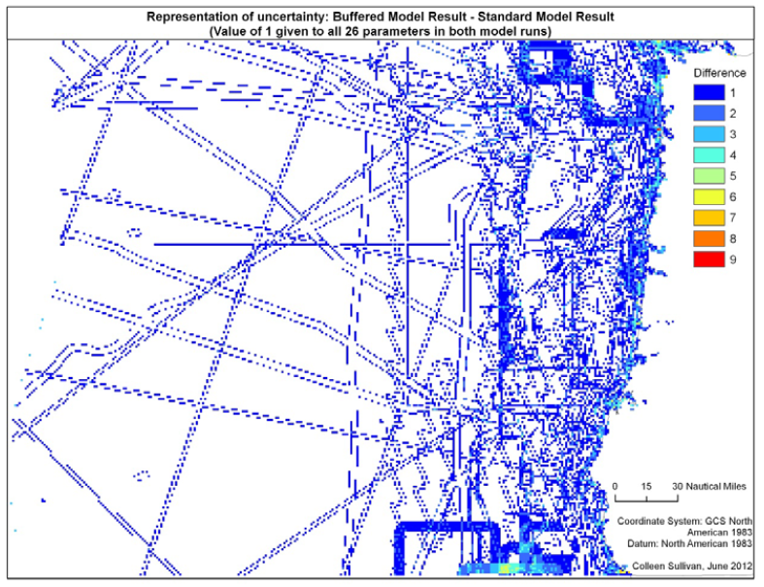
Communicating Uncertainy
Colleen Sullivan, 2012

Slide 40
Additional Slides

Slide 41
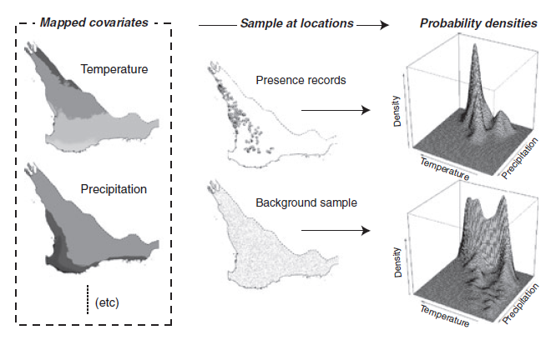
Habitat Suitability Models
Adjusting number of occurrences for the amount of habitat
Jane Elith1*, Steven J. Phillips2, Trevor Hastie3, Miroslav Dudı´k4,
Yung En Chee1 and Colin J. Yates5, A statistical explanation of MaxEnt for ecologists

Slide 42
Removing Biased Dates
Histogramming the dates can show the dates are biased
If you need dates at higher resolution than years and the “precision” of the date was not recorded, the only choice is to remove all dates from midnight on January 1st.

Slide 43
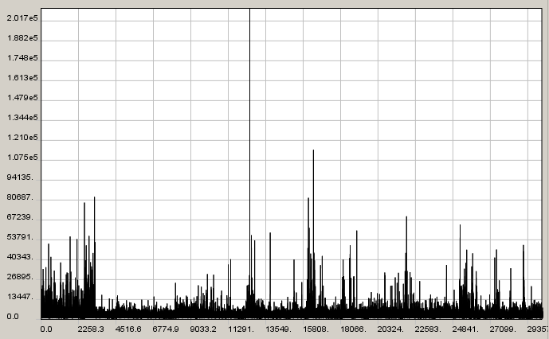
Histogram – Fire Data
Histogram of Minimum Distances
Number of Occurrences
Minimum Distance Between Points

Slide 44

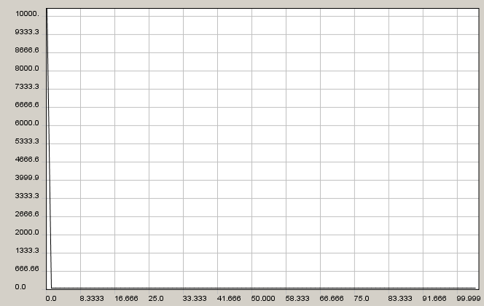
Uniform Data
Histogram of Minimum Distances
Number of Occurrences
Minimum Distance Between Points

Slide 45
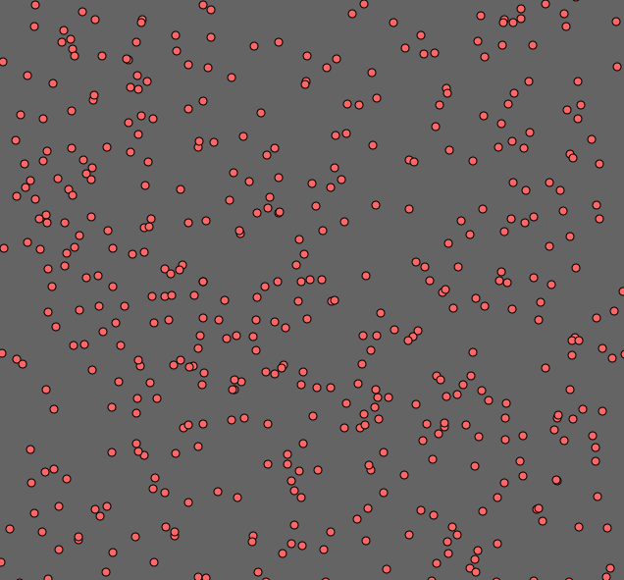
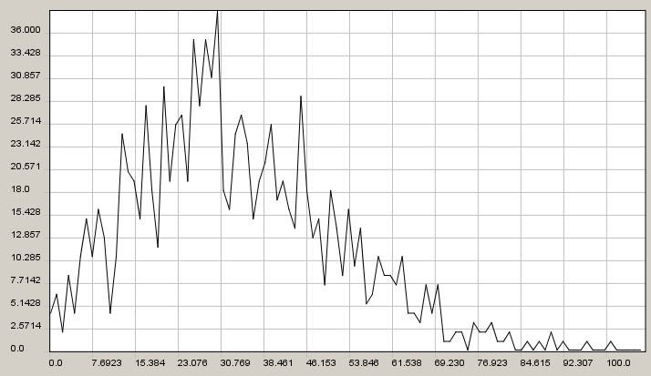
“Random” Data
Histogram of Minimum Distances
Number of Occurrences
Minimum Distance Between Points

Slide 46


Slide 47
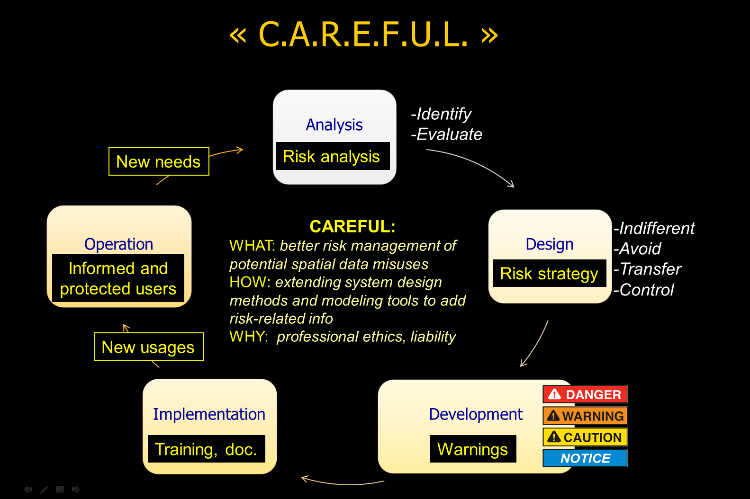

Slide 48
FGDC Standards
Federal Geographic Data Committee FGDC-STD-007.3-1998
Geospatial Positioning Accuracy Standards
Part 3: National Standard for Spatial Data Accuracy
  Root Mean Squared Error (RMSE) from HIGHER accuracy source
  Accuracy reported as 95% confidence interval
http://www.fgdc.gov/standards/projects/FGDC-standards-projects/accuracy/part3/chapter3
Section 3.2.1

Slide 49
What does your discipline do?
Varies with discipline and country
Check the literature
Opportunities for new research?

Slide 50
Slides for Habitat Suitability

Slide 51
Resolution or Detail
Resolution = Resolving Power
Examples:
  What would be visible on a 30 meter LandSat image vs. a 300 meter MODIS image? A 60cm RS image?
  What is the length of the coast line of China?

Slide 52
Road Map of Uncertainty
Spatial Precision
Spatial Accuracy
Sample Bias
Identification Errors
Date problems
Gross Errors
Gridding
Sample Data
Predictor Layers
Noise
Correlation
Interpolation Error
Spatial Errors
Measurement Errors
Temporal Uncertainty
Over fitting?
Assumptions?
Modeling Software
Settings
How to determine?
Habitat Map
Response Curves
Model Performance Measures
Number of Parameters
AIC, AICc, BIC, AUC
Realistic?
Uncertainty maps?
Match expectations?
Over-fit?
Accurate measures?
What is the best model?
Notes:
Best model can vary based on the application and the available data

Slide 53
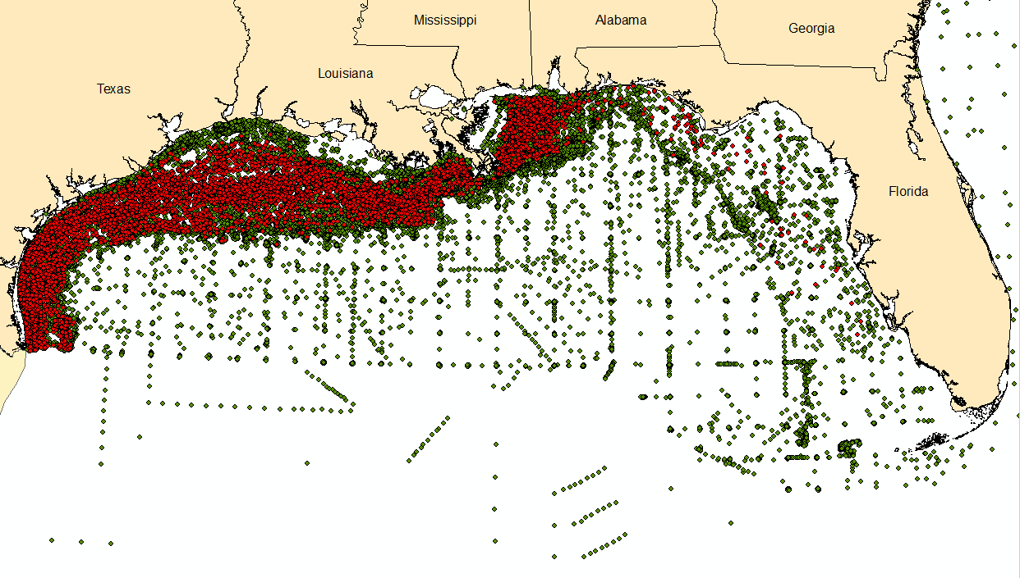
SEAMAP Trawls (>47,000 records)
Red Snapper Occurrences (>6,000 records)

Slide 54
Jiggling The Samples
Randomly shifting the position of the points based on a given standard deviation based on sample uncertainty
Running the model repeatedly to see the potential effect of the uncertainty

Slide 55
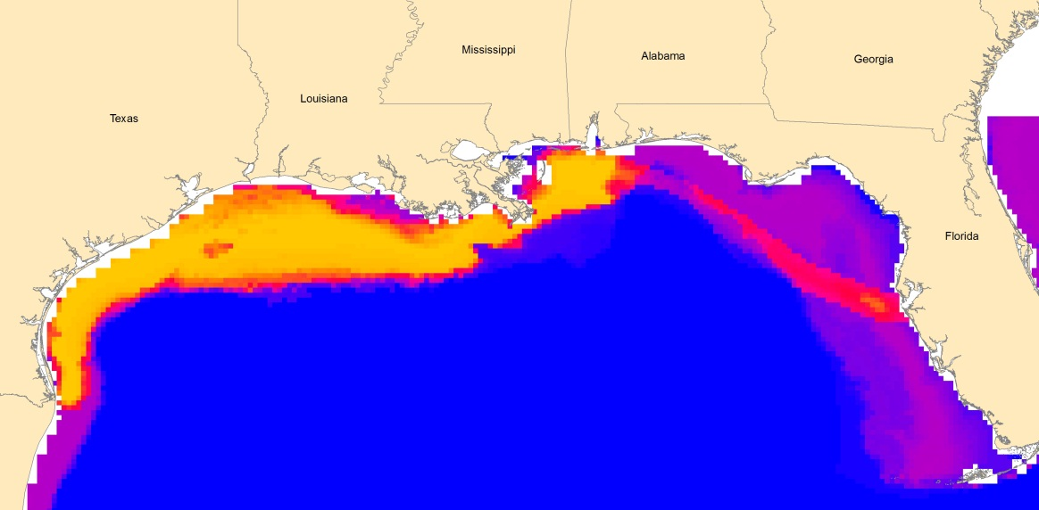
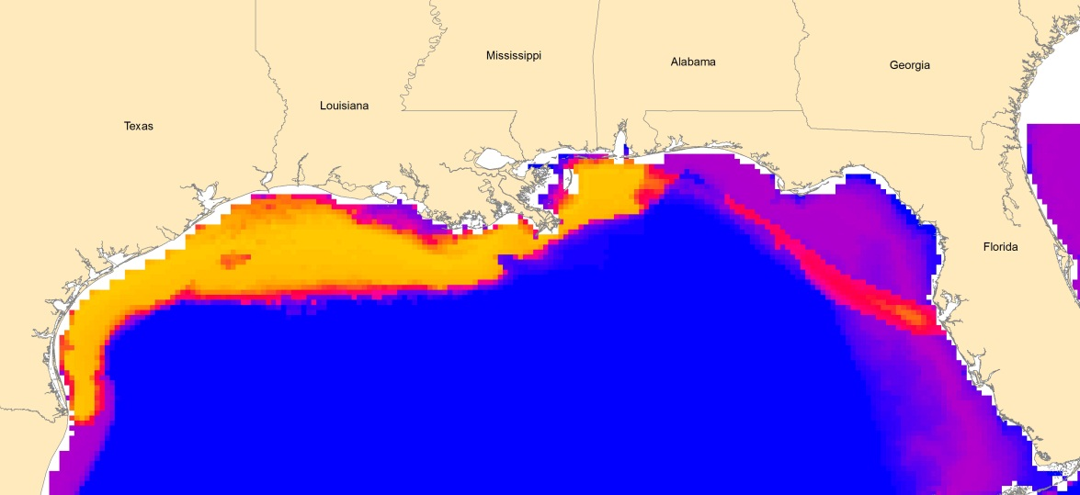
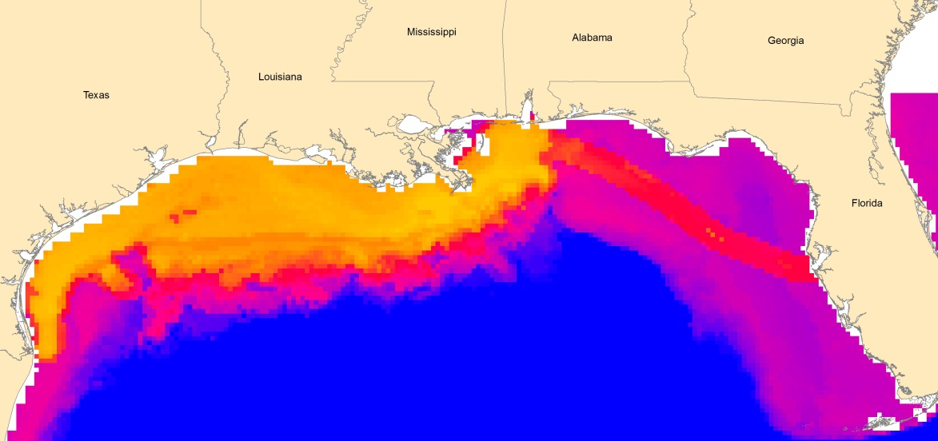
Jiggling
No Jiggling
Std Dev=4.4km
Std Dev=55km

Slide 56
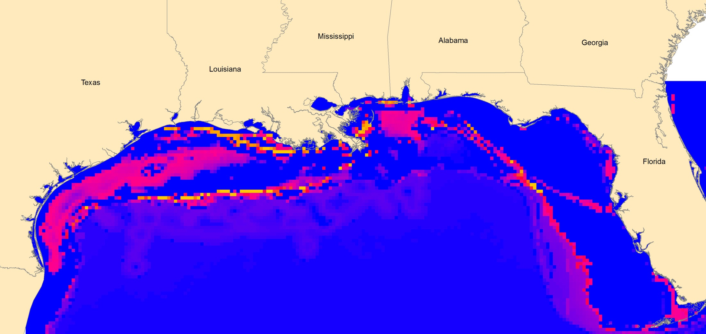
Uncertainty Maps
Standard Deviation of Jiggling Points by 4.4km
0.0008
0.32

Slide 57
Bottom Lines
Much harder to estimate uncertainty than to record it in the field
We need to do the best we can to:
  Investigate uncertainty
  Make sure data is appropriate for use
  Communicate uncertainty and risks
Don’t be like preachers
  Be like meteorologists

Slide 58
Pocket Slides
This material will be used as needed to answer questions during the lectures.

Slide 59
GPS
Calibration
Dilusion of Precision: manufacturer defined!
Esimate: Repeated measurements against benchmark
  Precision and Accuracy

Slide 60
Calibration
Sample a portion of the study area repeatedly and/or with higher precision
  GPS: benchmarks, higher resolution
  Measurements: lasers, known distances
  Identifications: experts, known samples

Slide 61
Processing Error
Error changes with processing
The change depends on the operation and the type of error:
  Min/Max
  Average Error
  Standard Error of the Mean
  Standard Deviation
  Confidence Intervals
There are “pocket slides” at the end of the lecture for more info on this approach

Slide 62
Storage Errors: Excel
10/2012 -> Oct-2012
  However, Excel stores 10/1/2012!
1.00000000000001 -> 1
  However, Excel stores 1.00000000000001
1.000000000000001 -> 1
  Excel stores 1

Slide 63
Significant Digits (Figures)
How many significant digits are in:
  12
  12.00
  12.001
  12000
  0.0001
  0.00012
  123456789
Only applies to measured values, not exact values (i.e. 2 oranges)

Slide 64
Significant Digits
Cannot create precision:
  1.0 * 2.0 = 2.0
  12 * 11 = 130 (not 131)
  12.0 * 11 = 130 (still not 131)
  12.0 * 11.0 = 131
Can keep digits for calculations, report with appropriate significant digits

Slide 65
Rounding
If you have 2 significant digits:
  1.11 -> ?
  1.19 -> ?
  1.14 -> ?
  1.16 -> ?
  1.15 -> ?
  1.99 -> ?
  1.155 -> ?
Notes:
- 1.155 would be 1.2

Slide 66
Managing Uncertainty
Raster - Spatial | Error in geo-referencing – Difficult to track, use worse case from originals
Raster – Pixel Values | Compute Accuracy and Precision from original measures, update throughout processing. Best case, maintain: Accuracy and Precision rasters
Vector – Spatial | Difficult to compute through some processes (projecting). Use worse case from originals or maintain “control” dataset throughout process.
Vector – Attributes | Compute accuracy and precision from original measures, update throughout processing.

Slide 67
Other Approaches
Confidence Intervals
+- Some range
  Min/Max
  Need a confidence interval
“Delusion of Precision”
  Defined by the manufacturer

Slide 68
Combing Bias
Derived by Jim Graham
Add/Subtraction:
  Bias (Bias1+Bias2)=
    T- (Mean1*Num1+Mean2*Num2)/(Num1*Num2)
    Simplified: (|Bias1|+|Bias2|)/2
Multiply Divide:
  Bias (Bias1*Bias2)=
    T- (Mean1*Mean2)
    Simplified: |Bias1|*|Bias2|

Slide 69
Combining Standard Deviation
http://www.rit.edu/cos/uphysics/uncertainties/Uncertaintiespart2.html
Add/Subtract:
  StdDev=sqrt(StdDev1^2+StdDev2^2)
Multiply/Divide:
  StdDev=
    sqrt((StdDev1/Mean1)^2+(StdDev2/Mean2)^2)

Slide 70
Exact numbers
Adding/Subtracting:
  Error does not change
Multiplying:
  Multiply the error by the same number
  E2 = E1 * 2

Slide 71
Human Measurements

Slide 72
 | Space | Time | Attribute | Scale | Relationships
Accuracy | Positional | Temporal | Attribute | - | -
Precision | Repeatability, Sig. Digits | Year, Month, Day, Hour | Sig. Digits | - | -
Resolution (Detail) | Detail, Cell Size | Year, Month, Day, Hour |  | - | -
Logical Consistency | Locational | Temporal | Domain |  | Topologic
Completeness |  |  |  | Completeness

Slide 73
Examples
Resolution or cell size in a raster
How close is a stream centerline to the actual centerline?
How close is a lake boundary?
How close is a city point to the city?
How good is NLCD data?

